Slide 1
Reading the Mind: Cognitive Tasks and fMRI data: the improvement
Omer Boehm, David Hardoon and Larry Manevitz
IBM Research Center and University of Haifa,
University College. London
University of Haifa

Slide 2
Cooperators and Data
Ola Friman; fMRI Motor data from the Linköping University (currently in Harvard Medical School)
Rafi Malach, Sharon Gilaie-Dotan and Hagar Gelbard fMRI Visual data from the Weizmann Institute of Science

Slide 3
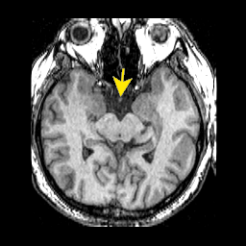
Challenge: Given an fMRI
Can we learn to recognize from the MRI data, the cognitive task being performed?
Automatically?
WHAT ARE THEY?
Omer Boehm
Thinking Thoughts

Slide 4
Our history and main results
2003 Larry visits Oxford and meets ambitious student David.
Larry scoffs at idea, but agrees to work
2003 Mitchells paper on two class
2005 IJCAI Paper – One Class Results at 60% level; 2 class at 80%
2007 Omer starts to work
2009 Results on One Class – almost 90% level
Almost first public exposition of results, today. Reason for improvement: we “mined” the correct features.

Slide 5
What was David’s Idea and Why did I scoff?
Idea: fMRI scans a brain while a subject is performing a task.
So, we have labeled data
So, use machine learning techniqes to develop a classifier for new data.
What could be easier?

Slide 6
Why Did I scoff?
Data has huge dimensionality
(about 120,000 real values in one scan)
Very few Data points for training
MRIs are expensive
Data is “poor” for Machine Learning
Noise from scan
Data is smeared over Space
Data is smeared over Time
People’s Brains are Different; both geometrically and (maybe) functionally
No one had published any results at that time

Slide 7
Automatically?
No Knowledge of Physiology
No Knowledge of Anatomy
No Knowledge of Areas of Brain Associated with Tasks
Using only Labels for Training Machine

Slide 8
Basic Idea
Use Machine Learning Tools to Learn from EXAMPLES Automatic Identification of fMRI data to specific cognitive classes
Note: We are focusing on Identifying the Cognitive Task from raw brain data; NOT finding the area of the brain appropriate for a given task. (But see later …)

Slide 9
Machine Learning Tools
Neural Networks
Support Vector Machines (SVM)
Both perform classification by finding a multi-dimensional separation between the “accepted “ class and others
However, there are various techniques and versions

Slide 10
Earlier Bottom Line
For 2 Class Labeled Training Data, we obtained close to 90% accuracy (using SVM techniques).
For 1 Class Labeled Training Data, we had close to 60% accuracy (which is statistically significant) using both NN and SVM techniques
X

Slide 11
Classification
0-class Labeled classification
1-class Labeled classification
2-class Labeled classification
N-class Labeled classification
Distinction is in the TRAINING methods and Architectures. (In this work we focus on the 1-class and 2-class cases)

Slide 12
Classification

Slide 13
Training Methods and Architectures Differ
2 –Class Labeling
Support Vector Machines
“Standard” Neural Networks
1 –Class Labeling
Bottleneck Neural Networks
One Class Support Vector Machines
0-Class Labeling
Clustering Methods

Slide 14
One class
The system is trained ONLY with positive examples (no negative examples); yet in the end performs separation
Appropriate for when you have representative samples only for positive examples; negative examples only “accidental”.
Techniques
“Bottleneck” Neural Networks
One Class SVM

Slide 15
1-Class Training
Appropriate when you have representative sample of the class; but only episodic sample of non-class
System Trained with Positive Examples Only
Yet Distinguishes Positive and Negative
Techniques
Bottleneck Neural Network
One Class SVM

Slide 16
One Class is what is Important in this task!!
Typically only have representative data for one class at most
The approach is scalable; filters can be developed one by one and added to a system.

Slide 17
Bottleneck Neural Network
Fully Connected
Fully Connected
Output (dim n)
Compression (dim k)
Trained Identity Function
Input (dim n)

Slide 18
Bottleneck NNs
Use the positive data to train compression in a NN – i.e. train for identity with a bottleneck. Then only similar vectors should compress and de-compress; hence giving a test for membership in the class
SVM: Use the identity as the only negative example

Slide 19
Computational Difficulties
Note that the NN is very large (then about 10 Giga) and thus training is slow. Also, need large memory to keep the network inside.
Fortunately, we purchased what at that time was a large machine with 16 GigaBytes internal memory

Slide 20
Support Vector Machines
Support Vector Machines (SVM) are learning systems that use a hypothesis space of linear functions in a high dimensional feature space. [Cristianini & Shawe-Taylor 2000]
Two-class SVM: We aim to find a separating hyper-plane which will maximise the margin between the positive and negative examples in kernel (feature) space.
One-class SVM: We now treat the origin as the only negative sample and aim to separate the data, given relaxation parameters, from the origin. For one class, performance is less robust…

Slide 21
Historical (2005) Motor Task Data: Finger Flexing (Friman Data)
Two sessions of data: a single subject flexing his index finger on the right hand;
Experiment repeated over two sessions ( as the data is not normalised across sessions).
The label consists of Flexing and not Flexing
12 slices with 200 time points of a 128x128 window
Slices analyzed separately
The time-course reference is built from performing a sequence of 10 tp rest 10 tp active.... to 200 tp.

Slide 22
Experimental Setup Motor Task – NN and SVM
For both methods the experiment was redone with 10 independent runs, in each a random permutation of training and testing was chosen.
One-class NN:
We have 80 positive training samples and 20 positive and 20 negative samples for testing
Manually crop the non-brain background, resulting in a slightly different input/output size for each slice of about 8,300 inputs and outputs.
One-Class Support Vector Machines
Used with Linear and Gaussian Kernels
Same Test-Train Protocol
We use OSU SVM 3.00 Toolbox http://www.ece.osu.edu/~maj/osu_svm/ and for the the Neural Network toolbox for Matlab 7

Slide 23
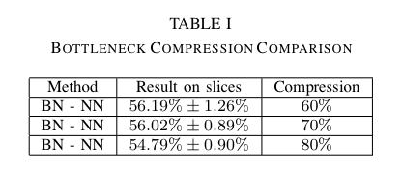
NN – Compression Tuning
A uniform compression of 60% gave the best results.
A typical network was about 8,300 input x about 2,500 compression x 8,300 output.
The network was trained with 20 epochs

Slide 24
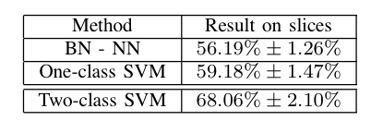
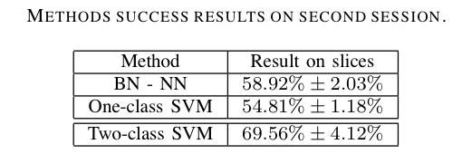
Results

Slide 25
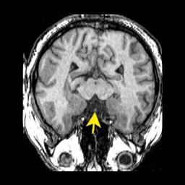
N-Class Classification
Faces
Object
Blank
Pattern
House

Slide 26
2-Class Classification
House
Blank

Slide 27
Two Class Classification
Train a network with positive and negative examples
Train a SVM with positive and negative examples
Main idea in SVM: Transform data to higher dimensional space where linear separation is possible. Requires choosing the transformation “Kernel Trick”.

Slide 28
Classification

Slide 29
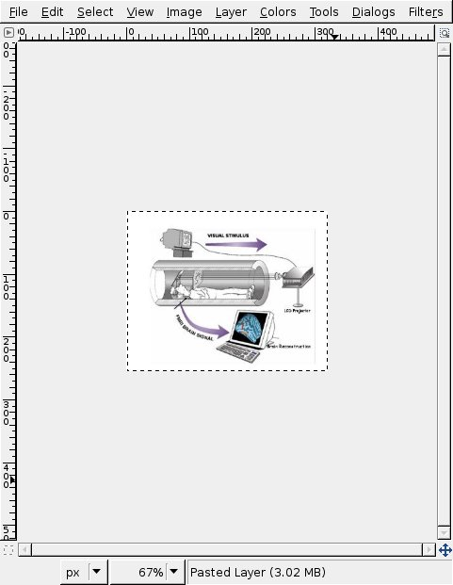
Visual Task fMRI Data (Courtesy of Rafi Malach, Weizmann Institute)
There are 4 subjects; A, B, C and D- with filters applied
Linear trend removal
3D motion correction
Temporal high pass 4 cycles (per experiment) except for D who had 5
Slice time correction
Talariach normalisation (For Normalizing Brains)
The data consists of 5 labels; Faces, Houses, Objects, Patterns, Blank

Slide 31
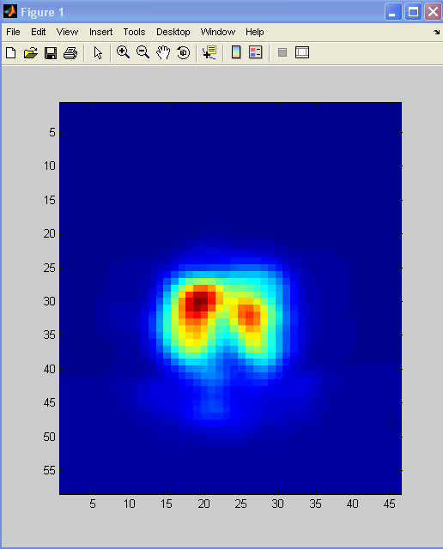
Two Class Classification
Visual Task Data
89% Success
Representation of Data
An Entire “Brain” i.e. one time instance of the entire cortex. (Actually used half a brain) so a data point has dimension about 47,000.
For each event, sampled 147 time points.

Slide 32
Per subject, we have 17 slices of 40x58 window (each voxel is 3x3mm) taken over 147 time points. (initially 150 time points but we remove the first 3 as a methodology)

Slide 33
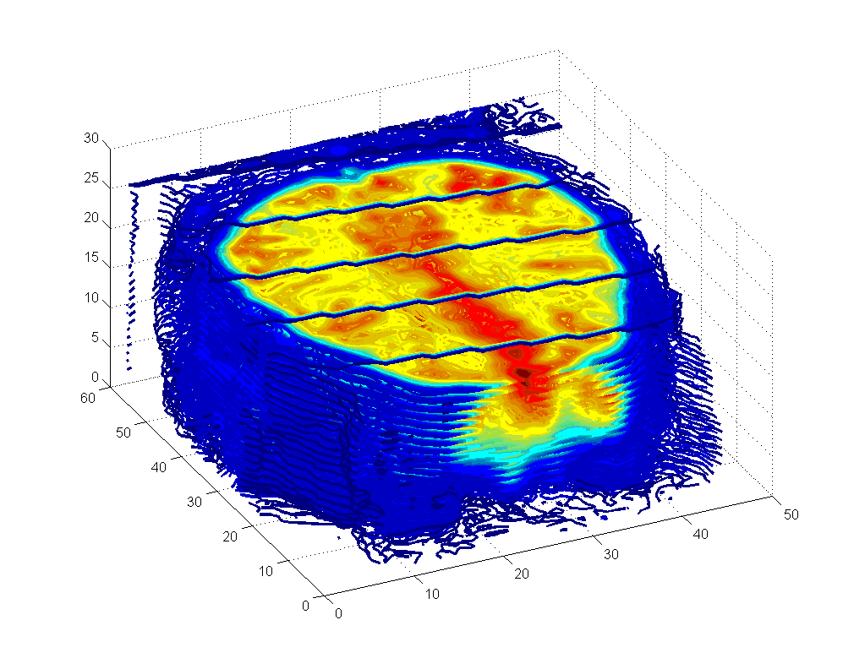
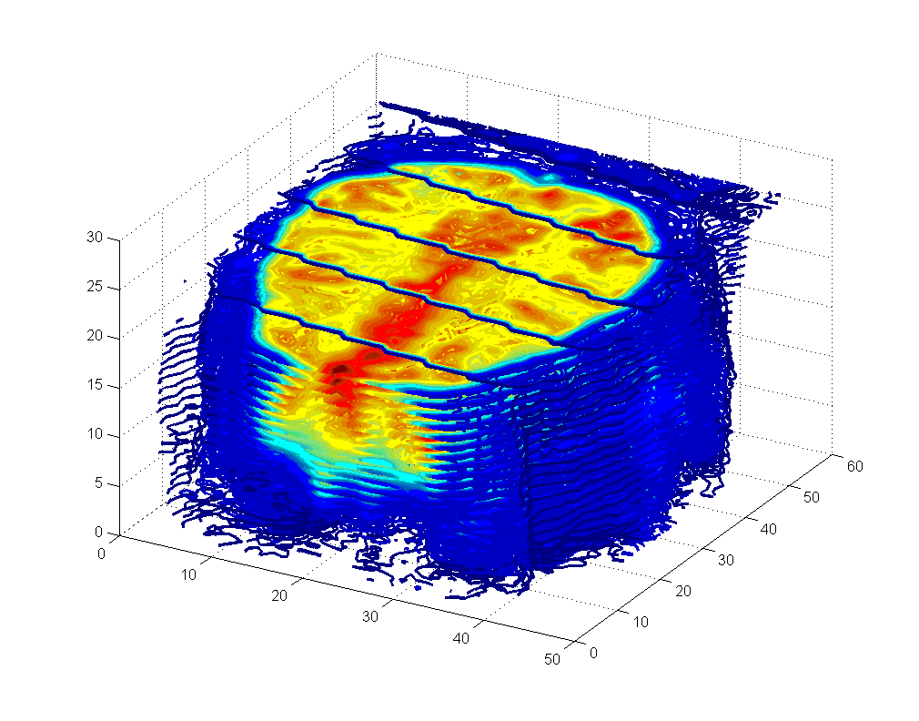
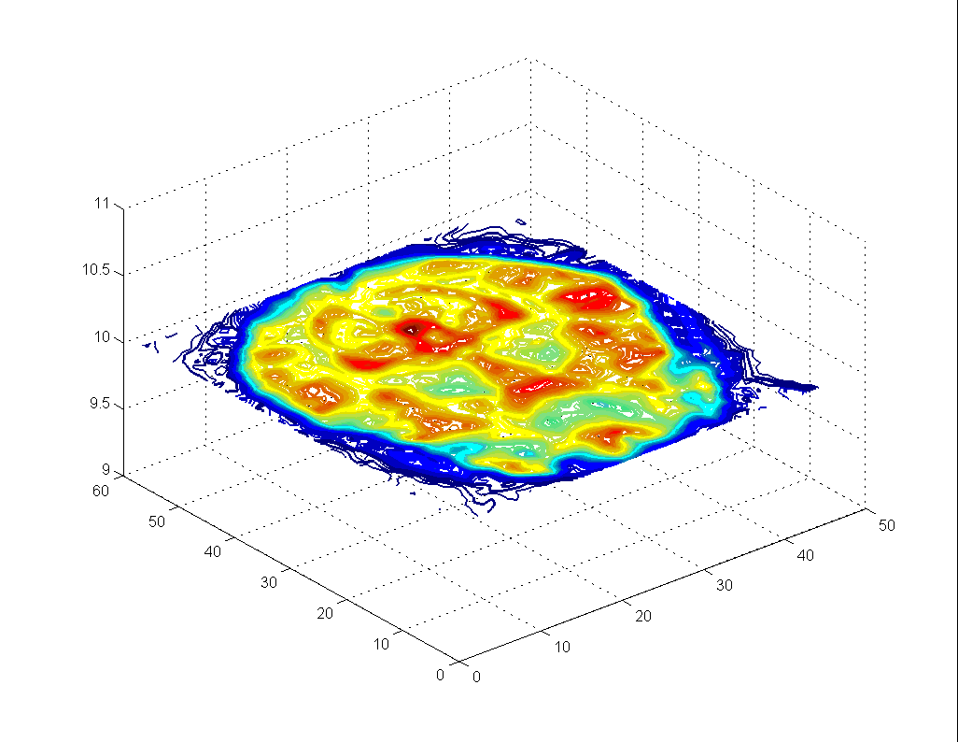
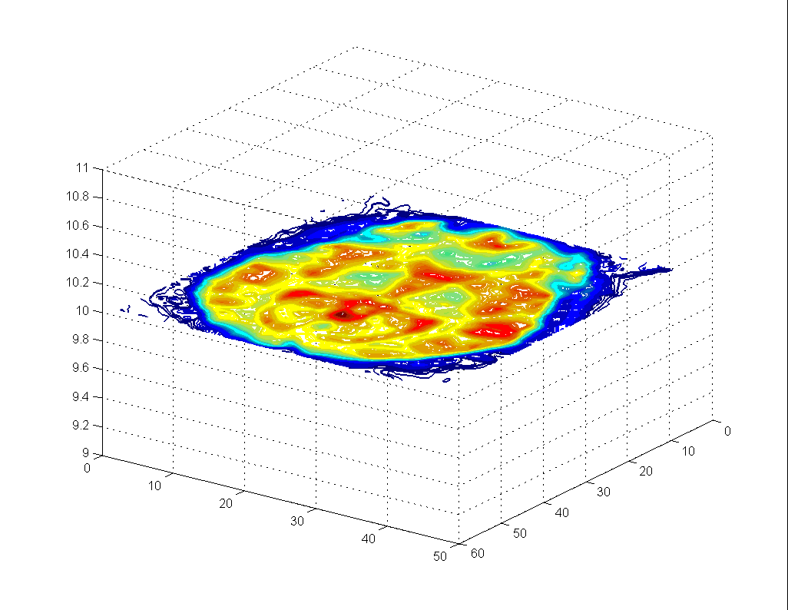
Typical brain images(actual data)

Slide 34
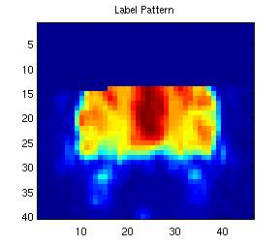
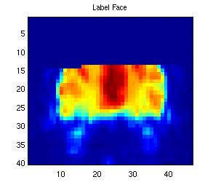
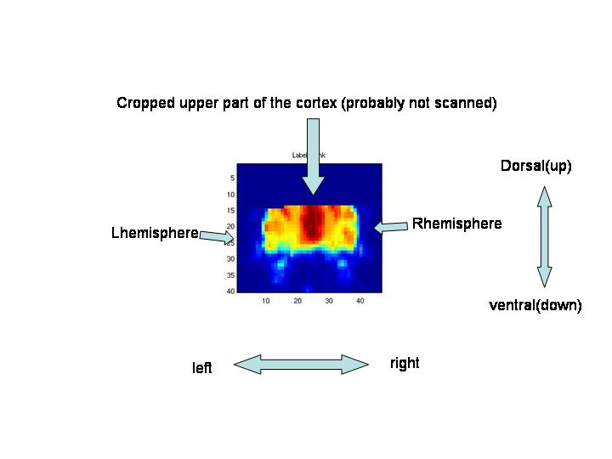
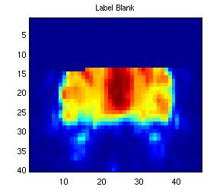
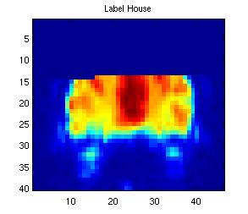

Some parts of data

Slide 35
Experimental Set-up
We make use of the linear kernel. For this particular work we use SVM package Libsvm available from http://www.csie.ntu.edu.tw/~cjlin/libsvm
Each experiment was run 10 time with a random permutation of the training-testing split
In each experiment we use subject A to find a global SVM penalty parameter C. We run the experiment for a range of C = 1:100 and select the C parameter which performed the best
For label vs. blank; we have 21 positive (label) and 63 negative (blank) labels (training 14(+) 42(-), 56 samples ; testing 7(+) 21(-), 28 samples.
Experiments on subjects
The training testing is split as with subject A
Experiments on combined-subjects
In these experiments we combine the data from B-C-D into one set; each label is now 63 time points and the blank is 189 time points.
We use 38(+) 114(-); 152 for training and 25(+) 75(-); 100 for testing.
We use the same C parameter as previously found per label class.

Slide 36
Experiments on subjects
The training testing is split as with subject A
Experiments on combined-subjects
In these experiments we combine the data from B-C-D into one set; each label is now 63 time points and the blank is 189 time points.
We use 38(+) 114(-); 152 for training and 25(+) 75(-); 100 for testing.
We use the same C parameter as previously found per label class.

Slide 37
Separate Individuals 2-Class
SVM Parameters Set by A
label vs. blank | Face | Pattern | House | Object
B | 83.21%±7.53% | 87.49%±4.2% | 81.78%±5.17% | 79.28%±5.78%
C | 86.78%±5.06% | 92.13%±4.39% | 91.06%±3.46% | 89.99%±6.89%
D | 97.13%±2.82% | 93.92%±4.77% | 94.63%±5.39% | 97.13%±2.82%

Slide 38
Combined Individuals 2Class SVM
Label vs. blank | Face | Pattern | House | Object
B & C & D (combined) | 86%±2.05% | 89.5%±2.5% | 88.4%±2.83% | 89.3%±2.9%

Slide 39
Separate Individuals 2 Class
Label vs. Label (older results)
label vs. label | Face | Pattern | House | Object
Face |  | 75.77%±6.02% | 77.3%±7.35% | 67.69%±8.91%
Pattern |  |  | 75.0%±7.95% | 67.69%±8.34%
House |  |  |  | 71.54%±8.73%

Slide 40
So Did 2-class work pretty well? Or was the Scoffer Right or Wrong?
For Individuals and 2 Class; worked well
For Cross Individuals, 2 Class where one class was blank: worked well
For Cross Individuals, 2 Class was less good
Eventually we got results for 2 Class for individual to about 90% accuracy.
This is in line with Mitchell’s results

Slide 41
What About One-Class?
SVM – Essentially Random Results
NN – Similar to Finger-Flexing
57% | Face
57% | House

Slide 42
So Did 1-class work pretty well? Or was the Scoffer Right or Wrong?
We showed one-class possible in principle
Needed to improve the 60% accuracy!

Slide 43
Feature Selection?
Can we narrow down the 120,000 features to find the important ones?
We intend to use different techniques on this – e.g. binary search with relearning to focus.
Alternatively – analyze weights to eliminate

Slide 44
Concept: Feature Selection?
Since most of data is “noise”:
Can we narrow down the 120,000 features to find the important ones?
Perhaps this will also help the complementary problem: find areas of brain associated with specific cognitive tasks

Slide 45
Relearning to Find Features
From experiments we know that we can increase accuracy by ruling out “irrelevant” brain areas
So do greedy binary search on areas to find areas which will NOT remove accuracy when removed
Can we identify important features for cognitive task? Maybe non-local?

Slide 46
Finding the Features
Manual binary search on the features
Algorithm: (Wrapper Approach)
Split Brain in contiguous “Parts” (“halves” or “thirds”)
Redo entire experiment once with each part
If improvement, you don’t need the other parts.
Repeat
If all parts worse: split brain differently.
Stop when you can’t do anything better.

Slide 47
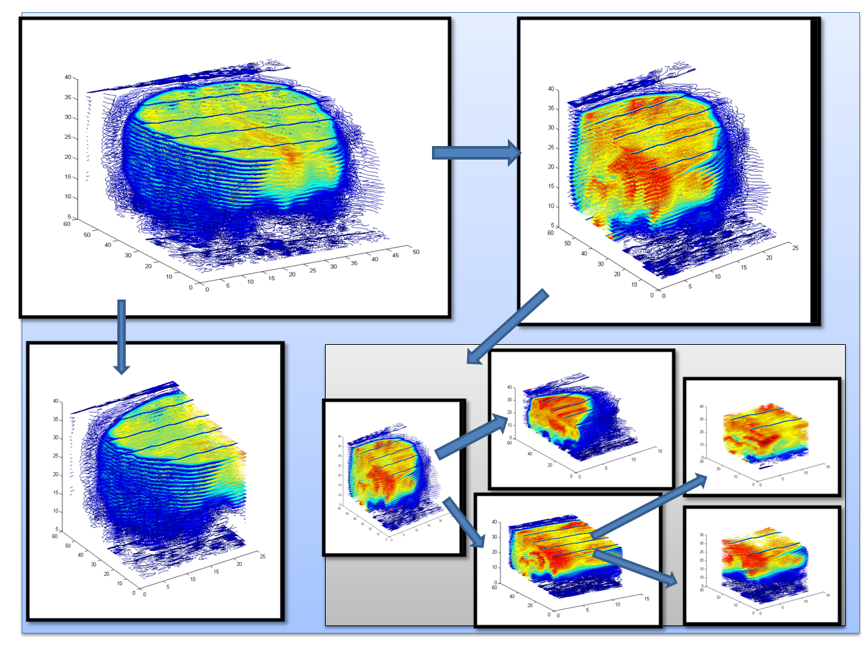
Binary Search for Features

Slide 48
Results of Manual Ternary Search

Slide 49
Results of Manual Greedy Search

Slide 50
Avg | Blank | Patterns | Objects | Houses | # features | [rows, columns, height] | Iteration
57% | 60% | 55% | 56% | 58% | 25194 | [ 1-17,1-39,1-38] | 1
62% | 65% | 64% | 55% | 62% | 28158 | [15-33,1-39,1-38] *
54% | 60% | 50% | 52% | 55% | 28158 | [30-48,1-39,1-38]
60% | 60% | 55% | 63% | 61% | 11115 | [15-33,1-39,1-15] | 2
70% | 70% | 72% | 68% | 69% | 13338 | [15-33,1-39,13-30] *
59% | 60% | 60% | 57% | 58% | 8892 | [15-33,1-39,27-38]
66% | 62% | 68% | 69% | 63% | 6318 | [15-23,1-39,13-30] | 3
73% | 79% | 76% | 67% | 70% | 4914 | [20-26,1-39,13-30] *
68% | 75% | 70% | 67% | 60% | 6318 | [25-33,1-39,13-30]
72% | 73% | 71% | 70% | 74% | 2808 | [20-23,1-39,13-30] * | 4
71% | 80% | 60% | 73% | 65%% | 2808 | [22-25,1-39,13-30]
69% | 68% | 69% | 69% | 70% | 2106 | [24-26,1-39,13-30]
67% | 63% | 74% | 65% | 67% | 1404 | [20-21,1-39,13-30] | 5
64% | 64% | 70% | 63% | 60% | 1404 | [21-22,1-39,13-30]
67% | 68% | 72% | 63% | 65% | 1404 | [22-23,1-39,13-30]
 |  |  |  |  |  |  | back
69% | 72% | 70% | 66% | 67% | 1296 | [20-23,1-18,13-30] | 6
72% | 78% | 72% | 70% | 67% | 1512 | [20-23,19-39,13-30]

Slide 51
Too Slow, too hard, not good enough; need to automate
About 75% 1 class accuracy
We then tried a Genetic Algorithm Approach together with the Wrapper Approach around the Compression Neural Network

Slide 52
Simple Genetic Algorithm
initialize population;
evaluate population;
while (Termination criteria not satisfied)
{
select parents for reproduction;
perform recombination and mutation;
evaluate population;
}
j

Slide 53
Automate Search Using Genetic Algorithm
Encoding technique (gene, chromosome)
Initialization procedure (creation)
Evaluation function (environment)
Selection of parents (reproduction)
Genetic operators (mutation, recombination)
Parameter settings (practice and art)

Slide 54
The GA Cycle of Reproduction
crossover
parents
children
mutation
Reproduction related to evaluation
New population
children
evaluated children
Elite members

Slide 55
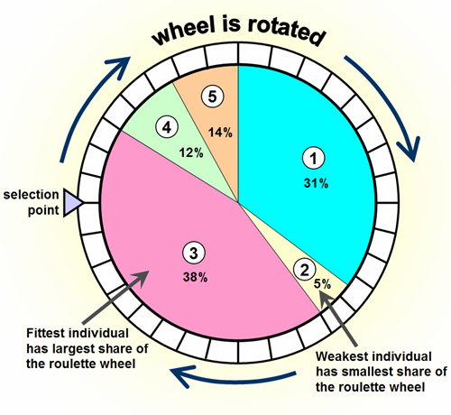
The Genetic Algorithm
Genome: Binary Vector of dimension 120,000
Crossover: Two point crossover randomly Chosen
Population Size: 30
Number of Generations: 100
Mutation Rate: .01
Roulette Selection
Evaluation Function: Quality of Classification

Slide 56
Computational Difficulties
Computational: Need to repeat the entire earlier experiments 30 times for each generation.
Then run over 100 generations
Fortunately we purchased a machine with 16 processors and 132GigaBytes internal memory.
So these are 80,000 NIS results!

Slide 57
Finding the areas of the brain?
Remember the secondary question?
What areas of the brain are needed to do the task?
Expected locality.

Slide 58
Typical brain images

Slide 59
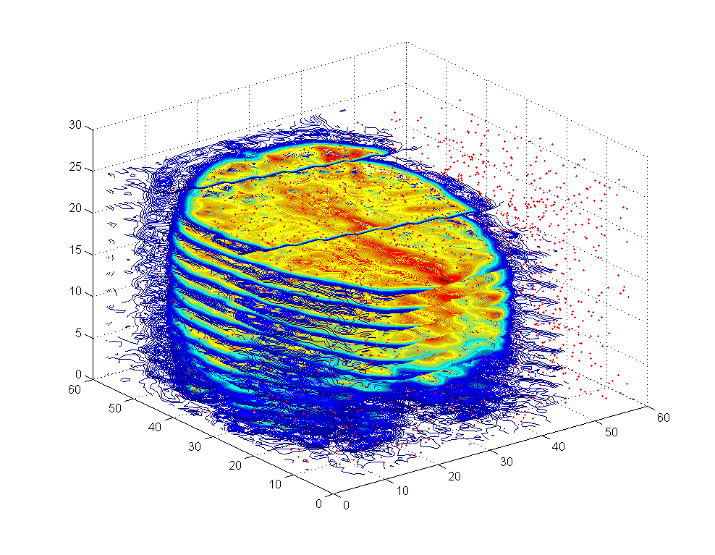
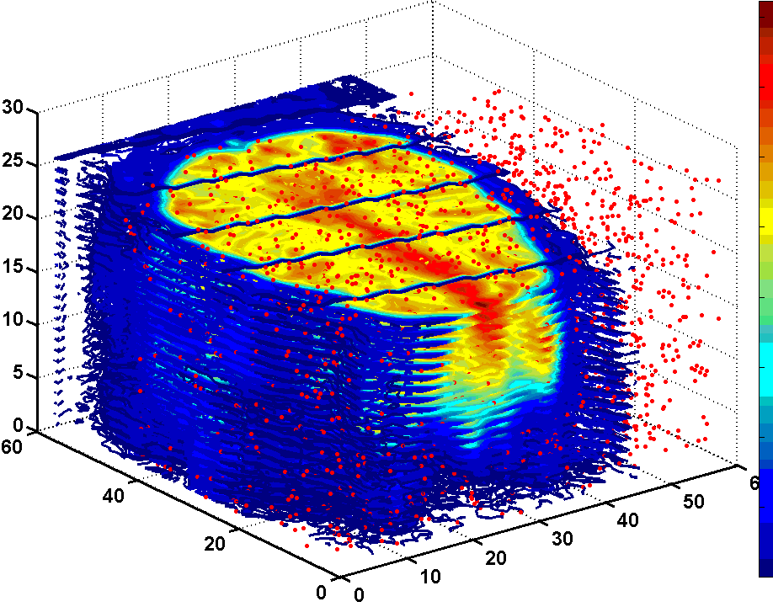
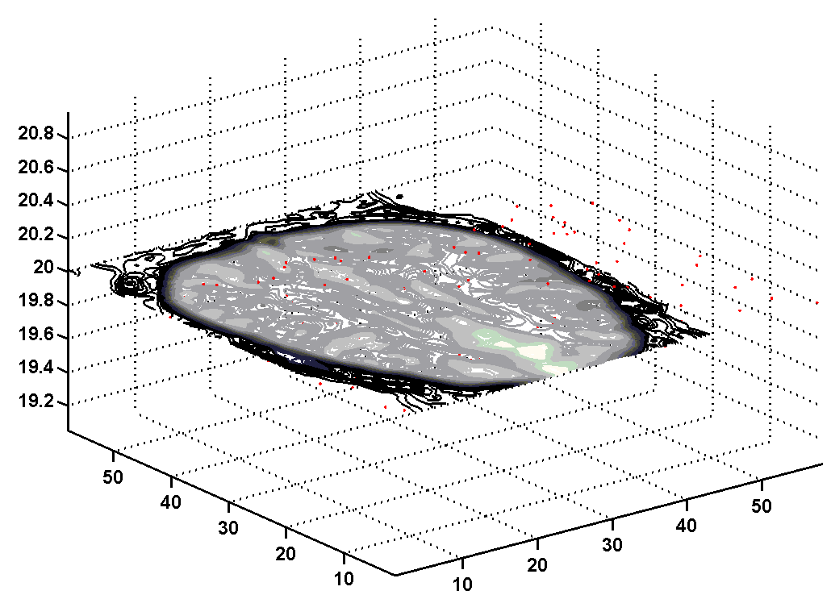
Masking brain images

Slide 60
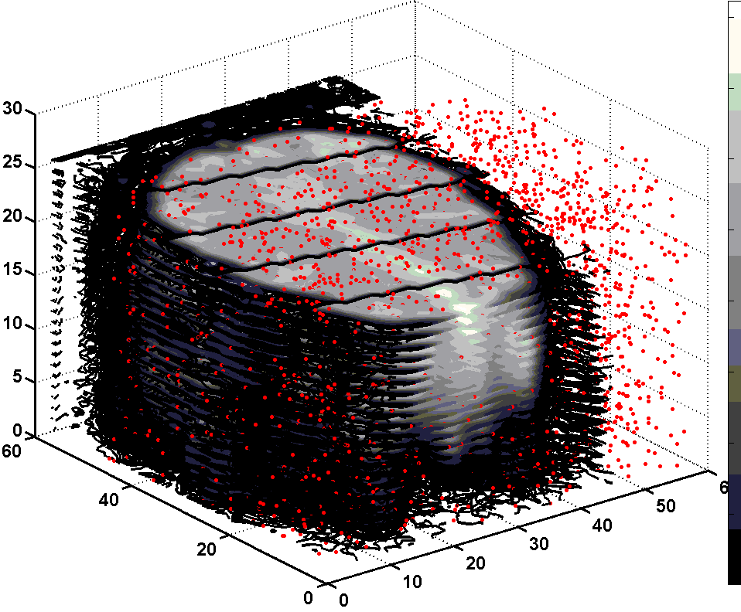

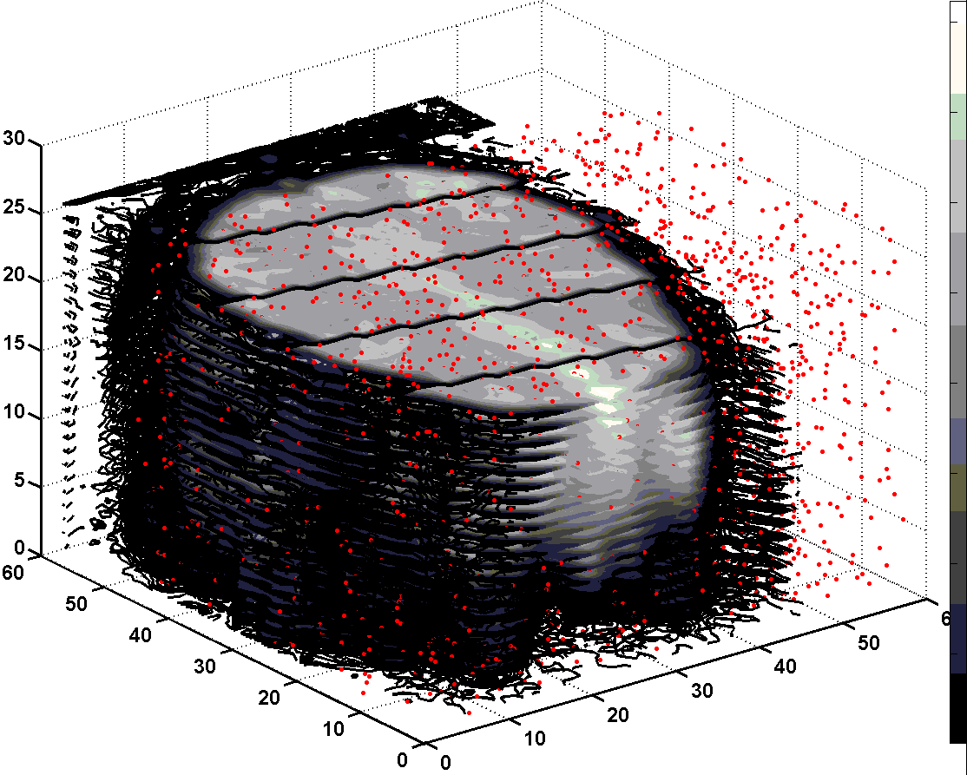
Number of features gets reduced
3748 features
3246 features
2843 features

Slide 61
Final areas

Slide 62
Areas of Brain
Not yet analyzed statistically
Visually:
We do *NOT* see local areas (contrary to expectations
Number of Features is Reduced by Search (to 2800 out of 120,000)
Features do not stay the same on different runs although the algorithm produces features of comparable quality

Slide 63
RESULTS on Same Data Sets: One class learning
Patterns | Objects | Houses | Faces | Category Filter
92% | 84% | 84% | - | Faces
92% | 83% | - | 84% | Houses
92% | - | 91% | 83% | Objects
- | 92% | 85% | 92% | Patterns
93% | 92% | 92% | 91% | Blank

Slide 64
Future Work
More verification (computational limits)
Push the GA further.
We did not get convergence but chose the elite member
Other options within GA
More generations
Different ways of representing data points
Find ways to close in on the areas or to discover what combination of areas are important.
Use further data sets; other cognitive tasks
Discover how detailed a cognitive task can be identified.

Slide 65
Summary – Results of Our Methods
2 Class Classification
Excellent Results (close to 90% already known)
1 Class Results
Excellent results (close to 90% over all the classses!)
Automatic Feature Extraction
Reduced to 2800 from 140,000 (about 2%).
Not contiguous features
Indications that this can be bettered.

Slide 66
Thank You
This collaboration was supported by the Caesarea Rothschild Institute, the Neurocomputation Laboratory and by the HIACS Research Center, the University of Haifa.
David thinking: I told you so!

Slide 67
Feature Selection
Can we find the areas in the brain associated with a task automatically?
These results suggest we can
Analyze Weights on Features for elimination
Use binary search and relearning to focus in on important features

Slide 68
Conjecture: Leveraging SVM and NN?
It seems that the kinds of errors on this data made by these two methods are different.
Both give a distance to decision level
Perhaps we can combine them to increase our accuracy?
We’ll be checking this shortly.

Slide 69
Summary - Results
2 Class Classification
Excellent Results (close to 90%)
1 Class Results
Good Results (close to 60%) on small amounts of data.
We have hypotheses which if correct, should result in substantial improvement
Ideas towards Feature Extraction
Would result in identification of locations in brain associated with cognitive tasks
Note: Even non-localized features!!

Slide 70
Discarded Slides Follow

Slide 71
Two Class SVM
Object | Pattern | House | Face
68 | 76% | 77% |  | Face
75% | 75% |  | 77% | House
68% |  | 75% | 76% | Pattern
 | 68% | 75% | 68% | Object

Slide 72
Justifications from Results
Motor Cortex – used slice representation
Visual Cortex – used full brain representation
Difference in results indicate that some areas are irrelevant. Hence should be able to focus in on the relevant areas by measuring results

Slide 73
One Class Classification
Motor Cortex
Data from Harvard
Visual Cortex
Data from Weizmann Institute
Results: 60% success. This is significant if not high enough to be useful in most applications.
More on this later

Slide 74
Evidence
On 1 –class; the low percentage comes from the use of slices without affect. Hence we expect to increase accuracy by ruling out such levels
On 2-class: by eliminating features, we should obtain the same

Slide 75
Bottom Line
2 Class Classification:
Visual Identification Tasks – About 90% success

Slide 76
Comparisons between GLM and Machine Learning Tools
Representation of the Data
NN identifies “as is”
SVM uses Kernels – implicit transformations to higher dimensional spaces.
The general linear model works by assuming the affect of a state is a convolution which can be represented by basis functions. The total state is a linear combination of these basis functions. Since these are functions of time, the evolution of the response is interpolated and given by all times
The NN and SVM method uses a static pattern recognition idea. The variance over time works because one gives examples over all the time period. Thus one can identify a static state of the brain without following its time course.
In the GLM, one finds appropriate features by a kind of sensitivity analysis. In NN and SVM we will use a search on the capability of
Learning after eliminating features.

Slide 77
Bottleneck Neural Network

Slide 78
Motor Data
Include Picture of Slices
Picture of a finger flexing ??

Slide 79
Cross Subject Application (Has Not Succeeded Yet)
Trained with One Subject
Tested on Other Subjects (separately)
Tested on Other Subjects (combined)

Slide 80
Experimental Setup
We use OSU SVM 3.00 Toolbox http://www.ece.osu.edu/~maj/osu_svm/ and for the the Neural Network toolbox for Matlab 7
For both methods the experiment was redone with 10 independent runs, in each a random permutation of training and testing was chosen.
One-class NN:
We have 80 positive training samples and 20 positive and 20 negative samples for testing
Manually crop the non-brain background, resulting in a slightly different input/output size for each slice of about 8,300 inputs and outputs.

Slide 81
Support Vector Machine
Used with a linear & RBF (Gaussian) kernel; default toolbox parameters.
Two-Class
We randomly select 160 training images and use the remaining 40 for testing.
One-Class
Same train-test protocol as with one-class NN

Slide 82
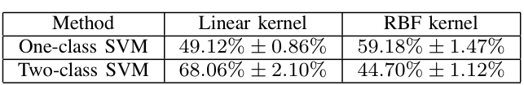
SVM Results
We therefore use a RBF kernel for the one class and a Linear kernel for the two-class in the following presented results.

